Slide 1
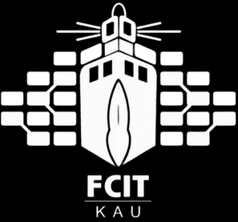
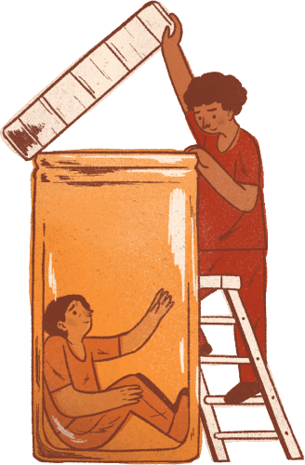
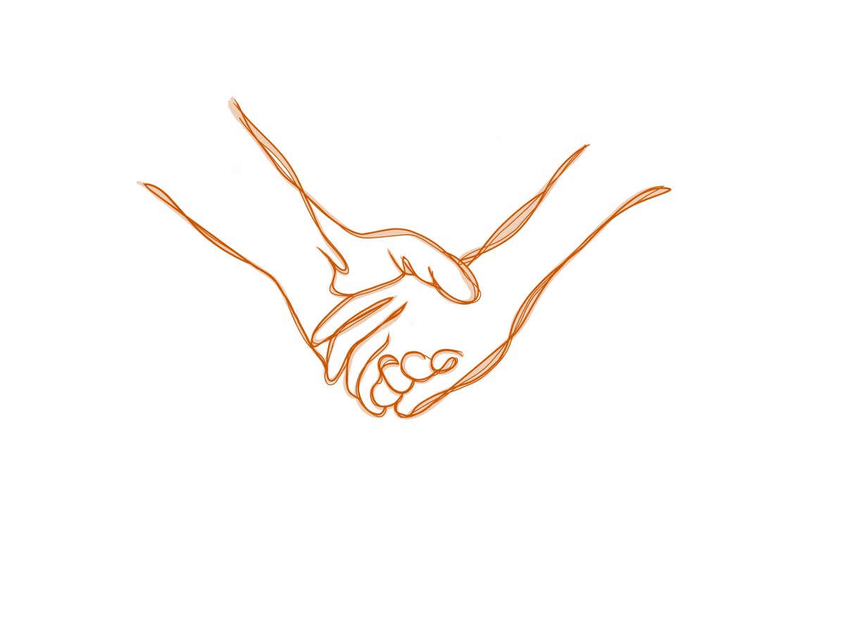



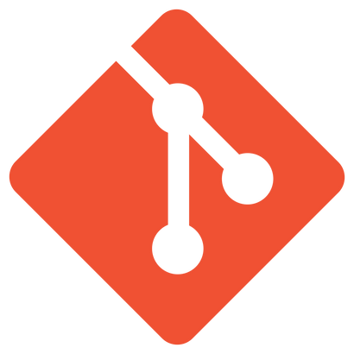
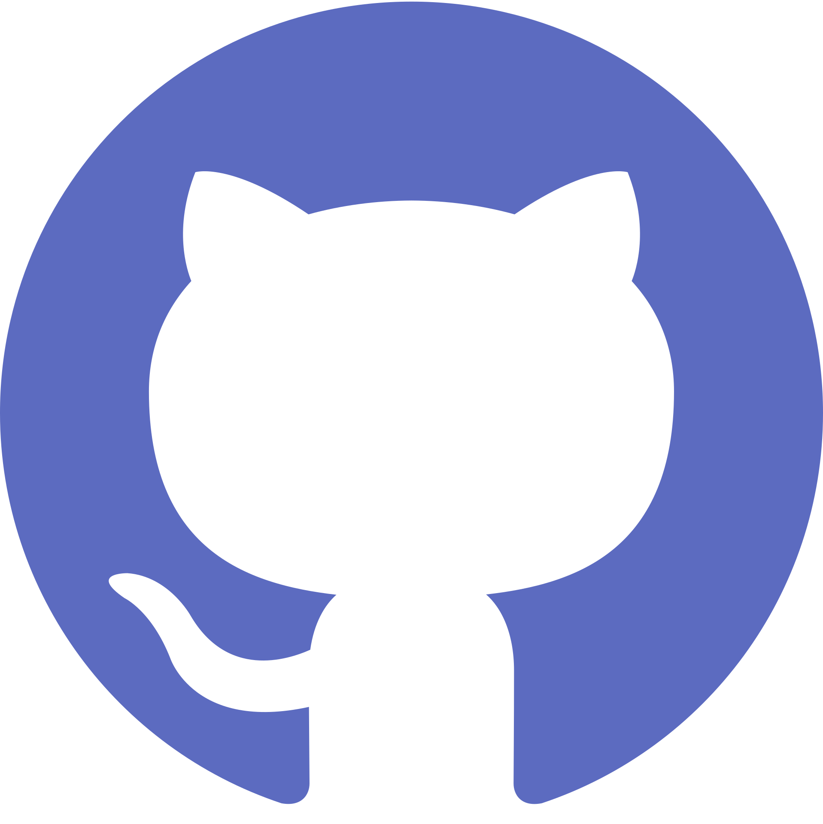
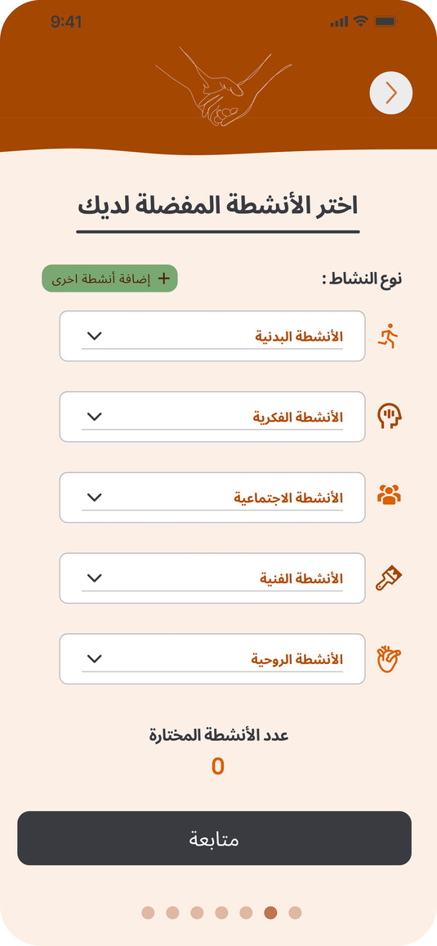
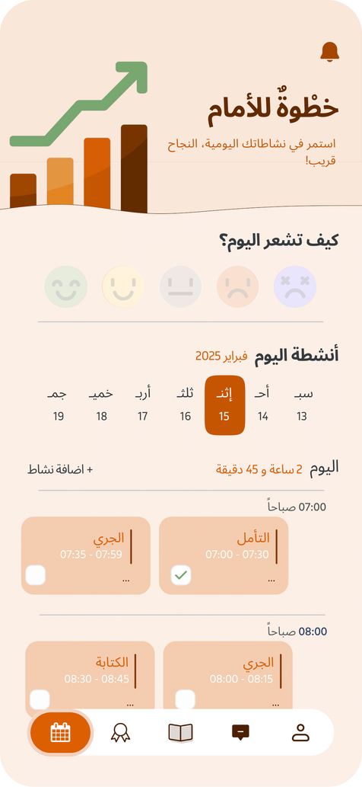
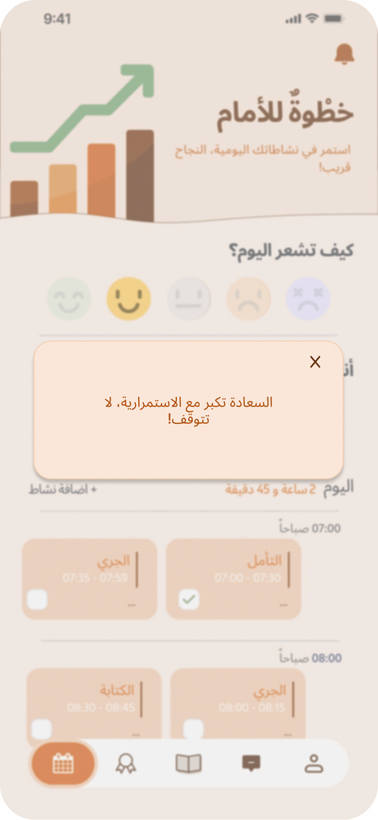
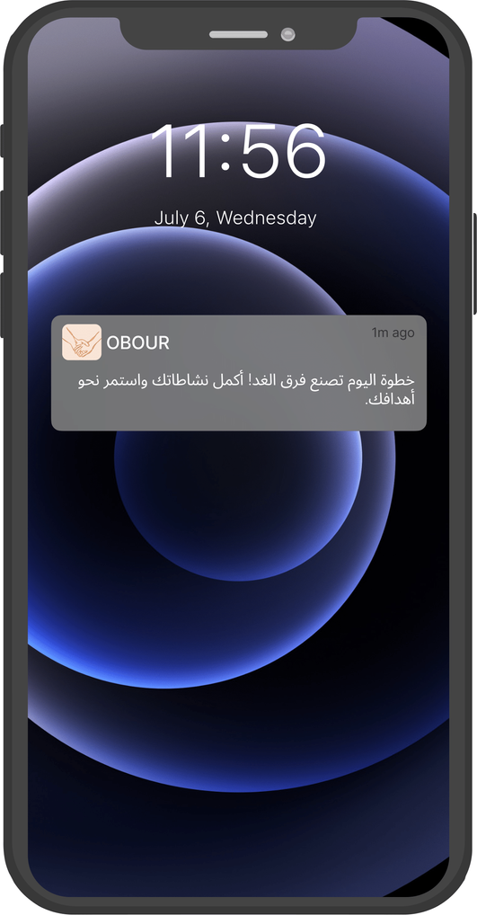
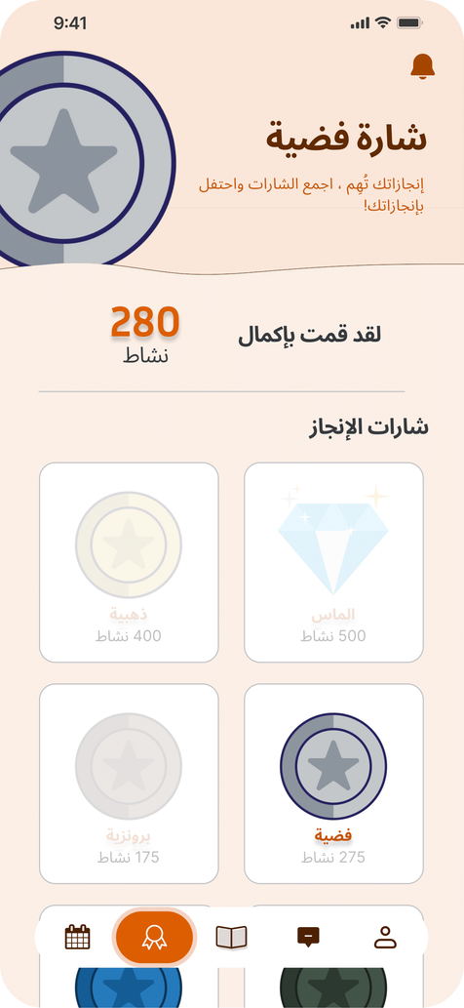
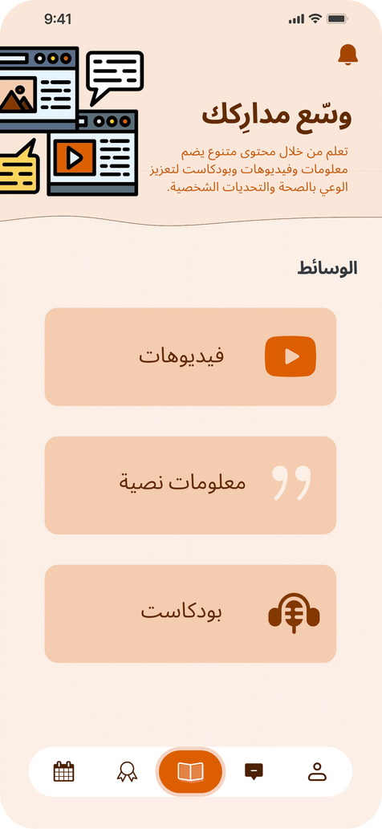
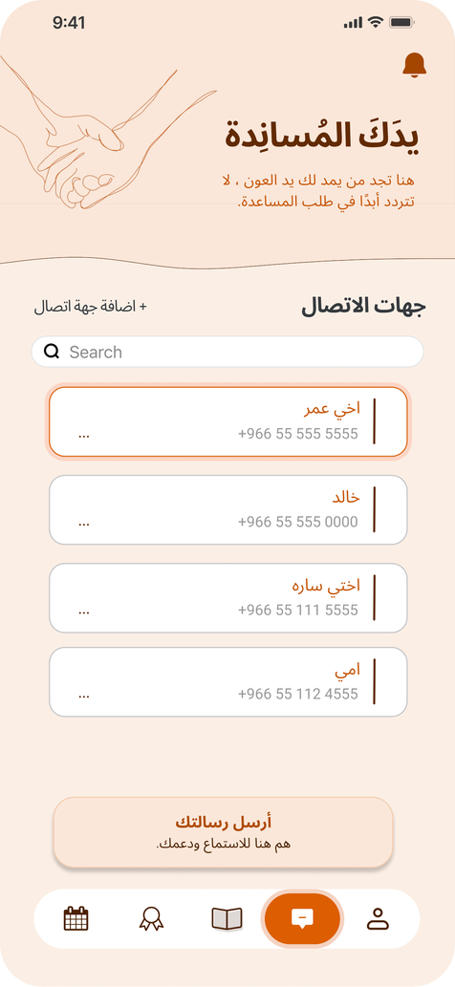
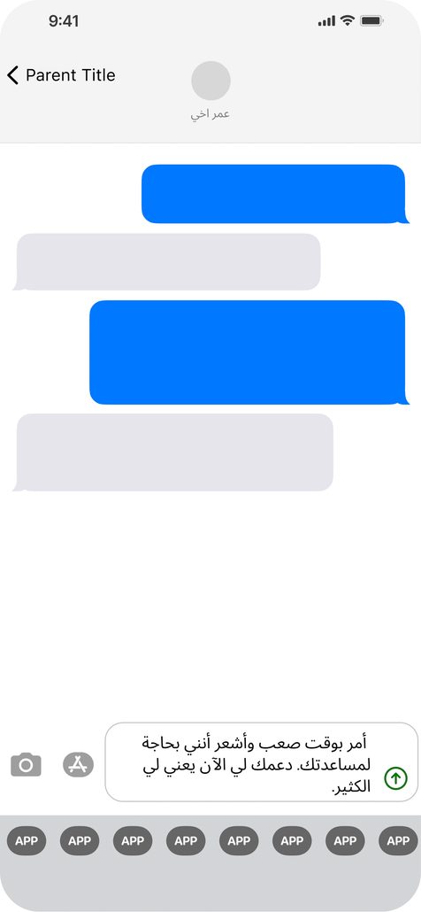
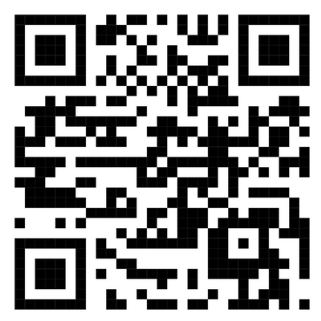
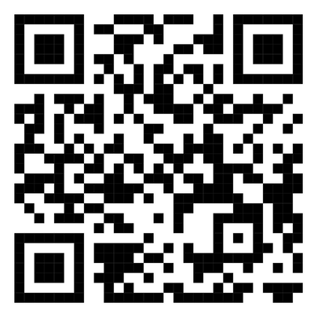
OBOUR
عبور
A Substance-use recovery system
Prepared By: Alaa Asghar, Reema Hesamudin, Bakirah Alseari
Supervised by: Dr. Taghreed Bagies
Abstract
Tools
Post-rehabilitation patients recovering from drug use often face emotional, cognitive, and social challenges. Obour is a culturally tailored mobile app for Arabic-speaking users in Saudi Arabia. It offers personalized recovery plans, and remainder for them, AI-generated motivational and religious quotes, progress tracking, achievement badge, peer SMS support, and educational content. Obour provides long-term support to help patients maintain sobriety and rebuild their lives after addiction treatment.
Flutter
Firebase
ChatGPT
Git
Github
Prototype
Objectives
Developing strategies for more personalized and effective behavioral treatment approaches
Encouragement for continued recovery
Improvement in long-term success and societal reintegration
Enhancing motivation and self-esteem by acknowledging patients' efforts and achievements
Providing emotional support to help patients maintain hope during recovery
Building a support network that helps patients reach out for help and feel less isolated
Awareness raising about substance use disorder in society
Problem Definition
Post-rehabilitation patients face numerous challenges that hinder their recovery journey, including:
Memory issues
Depression and anxiety
Sobriety maintenance
Limited support for ongoing recovery
Lack of recovery apps tailored for Arabic speakers
Social reintegration challenges
Limited awareness of substance use disorder risks
Problem Solution
Acknowledgements
Solution
Obour app supports post-rehabilitation patients recovering from substance use disorder by providing:
A weekly activity plan
Activity progress tracking
Activity notification reminders
Achievement badges for completing activities
Supportive quotes based on the patient’s emotional state
SMS support messaging for peers
Educational information about substance use disorder
We begin by thanking Allah for His guidance in completing this project. Our heartfelt gratitude goes to our supervisor, Dr. Taghreed Bagies, for her invaluable mentorship and support. We also extend our thanks to everyone who contributed to our work, as well as to our families, friends, and King Abdulaziz University for their encouragement and resources.
Future Work
Future Work
Methodology
References
Contact us
Using AI to diagnose and scale the severity of drug use-related issues can enhance treatment precision and improve recovery progress
Using AI to create personalized activity plans for patients based on their interests can boost engagement and foster sustained rehabilitation
Gather
Requirements
Design
and
Analysis
Bulid Prototype
Implement
Test
Waterfall model
Scan Me
Scan Me

